Slide 1


Parch and Posey Acquisition
Group 3: Aditya Dutt, Tom Hultsch, Xander Izower, Sherleen Lee, Michelle Lie, Tsubasa Lin, Joy Sun, and Xufeng Tu

Slide 2


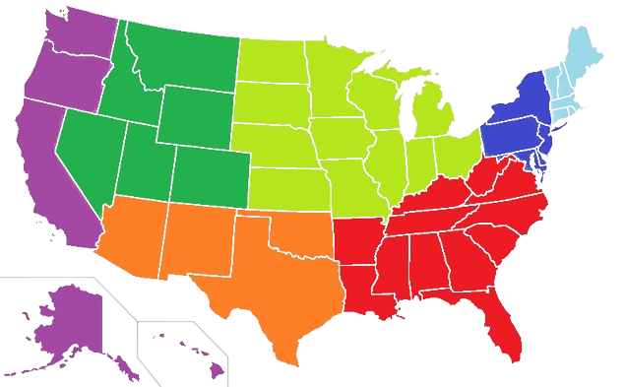

State of Parch and Posey
351 Accounts
Sales by Volume
7 Regions
Sales by Revenue
standard paper: 52.7% gloss paper: 27.6%
poster paper: 19.7%
Northwest
Midwest
Southwest
West
International
North
South
standard paper: 41.8% gloss paper: 32.8%
poster paper: 25.4%
Notes:
Q1-3: Aditya

Slide 3
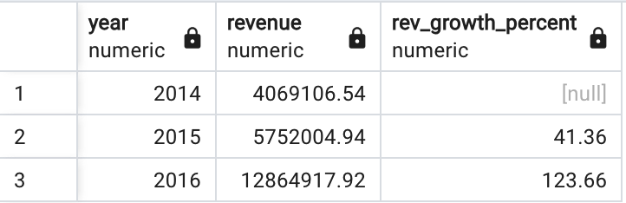
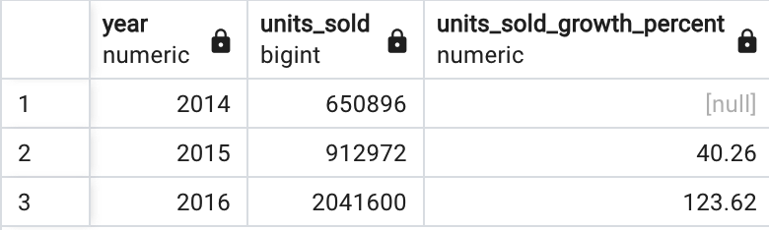
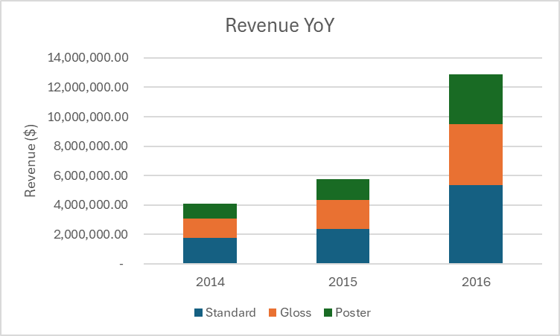
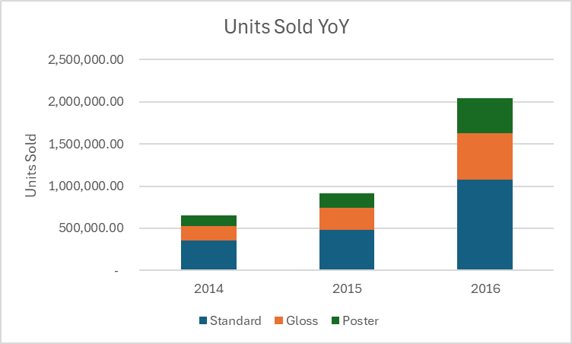
Year-over-year Growth
Notes:
Xander

Slide 4
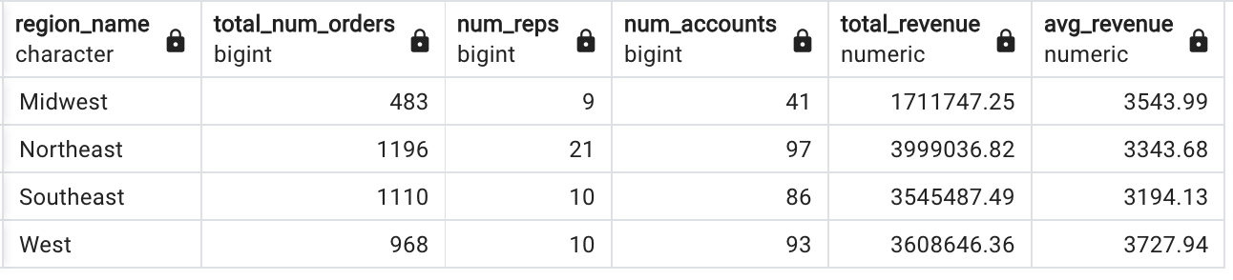
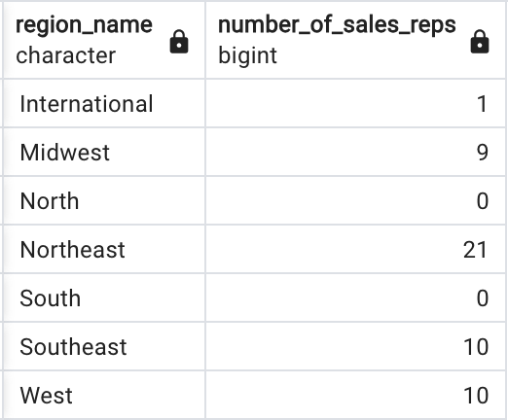
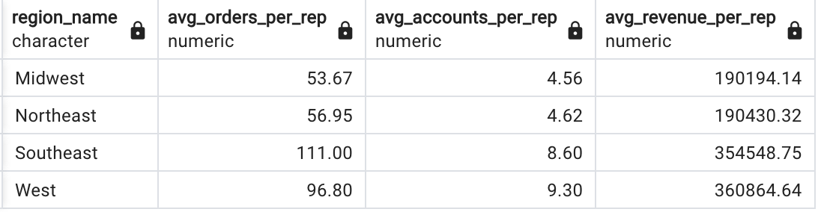

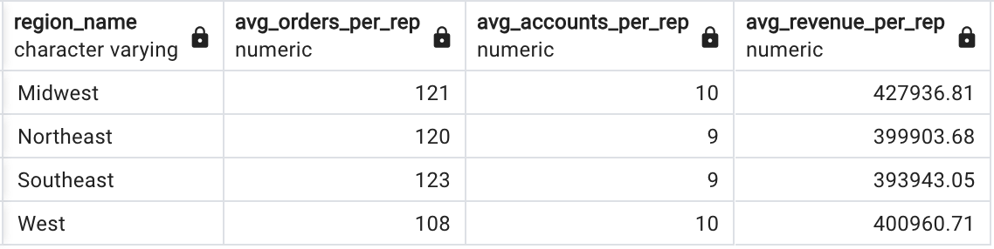
Current Regions and New Regions
Sales Rep Per Region:
-18
reps
- 11 sales reps from Northeast
- 5 reps from Midwest
- 1 rep each from South and North
Then split the 18 reps evenly amongst 3 new regions
Notes:
Stephen/Nicho

Slide 5

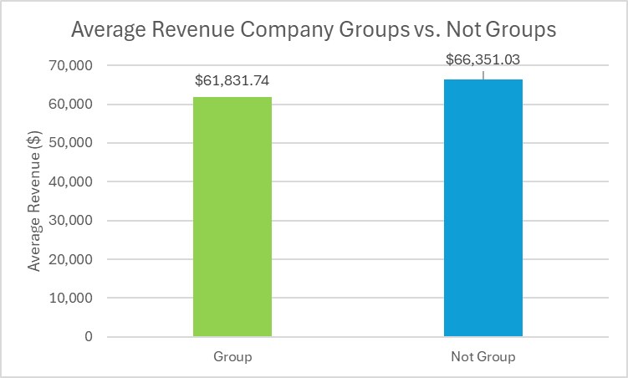

Customer Analysis and Outlook
Conglomerates or Groups do not necessarily constitute bigger accounts
Suggestions for Future Analysis
Understand Customer Needs
Segments that may require paper
Retail - Print Receipts
Media - Newspapers
Travel - Tickets/Labels
Notes:
Q4

Slide 6




Channels to Deactivate
 | Region | Channel | Channel Count (per Region) | Channel Count (% per Region)
 | Southeast | Twitter | 127 | 4.81%
 | West | Banner | 116 | 5.26%
 | Midwest | Banner | 59 | 5.05%
 | Northeast | Twitter | 154 | 5.03%
Notes:
Q8
In the event of an acquisition, the Marketing team needs to focus its resources on the newly added sales regions.
This means it will have to temporarily deactivate some channels in the old regions.
To do this, we filtered to only look at the channels in the old regions, and ranked the channels based on the number of times that the channel is used in web events per region. Here are some channels to be deactivated:
Twitter makes up 4.81% of web events in the southeast region
Banner makes up 5.26% of web events in the west
Banner makes up 5.05% of web events in the midwest
And twitter makes up 5.03% of web events in the northeast.
Hence, the marketing team should deactivate twitter in the southeast and northeast, and banner in the west and midwest.

Slide 7
More Directions to Explore
01
02
03
Parch & Posey’s Strength
Synergies
Cost and Regulation
Deeper look into the Company’s financial, management, and product strengths
See the value-added: target customers, market, company cultures, story, 1 + 1 > 2
Cost of the acquisition, additional investment, legal and regulatory landscape
Notes:
Here are some directions that we suggest Dunder Mifflin explore before making this acquisition. First and foremost, we suggest looking at Parch & Posey’s overall company strength, taking a deeper look into the company’s financials, especially the equity and debt ratio. Also, the management team: see if they demonstrate great leadership in the company. And assess product strengths such as paper quality to reduce damaged products.
Secondly, Dunder Mifflin should examine the synergy effects. See if the value and performance of the two companies combined would be greater than the company being by itself. We want to see the value added after acquiring P&P, such as a larger customer base, a more competitive advantage in the market, and whether the two companies' cultures blend well. At the end of the day, we still want to tell a story behind this acquisition.
Last but not least, it is important to consider the cost of this acquisition and the regulatory landscape since the U.S. has federal and state laws. If Dunder Mifflin is planning to expand into new regions, it would be crucial to examine the specific laws for that state.

Slide 8





Recommendation
There are other factors to be taken into account
Despite Parch and Posey’s strong revenue and sales growth…
Economic condition
Target customers
Due diligence and risk assessment
Notes:
After a thorough analysis on Parch and Posey’s customer growth, regions and channels, we conclude that Parch and Posey has a very strong revenue and sales growth over the years, with the growth in 2016 tripling the growth in 2015.
In order to decide whether or not to acquire Parch and Posey, we need to conduct further analysis, especially, we need to look at primary goal of acquisition. For example, if they are looking to expand our customer base to include more groups or conglomerates, then acquiring Parch and Posey may not be very wise as they have a pretty equal customer base between groups and non groups. Also we recommend to take a deeper look into the North, South and International regions before deciding on the acquisition, as we know nothing about these regions so far, Another thing to look at is the country’s economic condition, if the economy is in recession, then Dunder Mifflin may want to focus more on cost-cutting measures instead of this acquisition.
Lastly, they need to conduct proper due diligence and risk assessment of Parch and Posey. Other than the legal due diligence that they have to do by examining contracts and other legal documents, they also need to assess the operational due diligence by looking further into Parch and Posey’s operations such as supply chain, technology, and human resources. They can look into the company’s systems and processes to identify if there are any inefficiencies that may affect Dundlin negatively, or if there are any rooms for improvement.
All in all, although the numbers may look promising, we agreed that it is worth conducting further analysis on the other factors that may be related to the acquisition.
Emphasis on expansion on north, south, and international
Rn we know nth on these regions - demand, etc. so we evenly divide
Look deeper into these three regions
Explore further based on the suggestions

